Slide 1



Ad Valorem Homestead Property Taxes
June 2026

Slide 2
Topics to discuss…
How to read your tax bill
How your local city budget is set up
Fun with “Funds”
Worst-case scenario for homestead property tax elimination

Slide 3
How to Read Your Tax Bill
Let’s start with a monthly mortgage statement…
  “P - I – T - I”
    Principal
    Interest
    TAXES
    Insurance
    * Taxes and Insurance may be combined into “ESCROW”

Slide 4
How to Read Your Tax Bill
Let’s discuss what a “Homestead Property” is and qualifies for…
  Primary Residence – house, townhome, condo, etc.
  Does NOT include second homes, investment properties, commercial or industrial properties
  Qualifies for Homestead Exemptions and Save Our Homes (SOH) cap on annual assessment increases (3% or CPI, whichever is lower)

Slide 5
Current Homestead Tax Exemption
Homestead Exemptions and SOH
  $25k of the first $50k of assessment
  $25K of an assessment between $50k - $75k
  If assessed over $75k, property receives the $50k exemption
  Portability – homeowners can transfer up to $500k of their SOH benefit to a new home within three years
  Additional exemptions apply based on specific conditions

Slide 6
How to Read Your Tax Bill
Calculating your Tax Bill
  Millage Rate –
    The amount per $1,000 of taxable value used by local governments to calculate property taxes.
    Millage rates capped under State law at 10.0000 for municipalities
    School taxes are EXEMPT from Homestead and SOH exemption
  SOH - annual assessment increases capped at 3% or CPI, whichever is lower

Slide 7
Current Year Millage Rate Comparison

Slide 8
How to Read Your Tax Bill
Your tax bill does NOT all to go your city!
Three primary taxing authorities comprise your tax bill:
  Duval County / City of Jacksonville
  Duval County Public Schools
  Your City (the smallest of the three!)

Slide 9
Atlantic Beach
Where Your Property Tax Dollars Go
 | Millage | Property
 | Rate | Tax*
City of Atlantic Beach | 2.7499 | $750
Inland Navigation | 0.0270 | $7
Duval County School Board | 6.3430 | $1,889
Water Management District | 0.1793 | $49
City of Jacksonville | 7.9012 | $2,156
TOTAL | 17.2004 | $4,851
*Based on a median home assessed value of $322,820, with a homestead exemption
Final adopted millage rates per DR-403

Slide 10
Neptune Beach
Where Your Property Tax Dollars Go
 | Millage | Property
 | Rate | Tax*
City of Neptune Beach | 3.3656 | $918
Inland Navigation | 0.0270 | $7
Duval County School Board | 6.3430 | $1,889
Water Management District | 0.1793 | $49
City of Jacksonville | 7.9012 | $2,156
TOTAL | 17.8161 | $5,019
*Based on a median home assessed value of $322,820, with a homestead exemption
Final adopted millage rates per DR-403

Slide 11
Jacksonville Beach
Where Your Property Tax Dollars Go
 | Millage | Property
 | Rate | Tax*
City of Jacksonville Beach | 3.9947 | $1,090
Inland Navigation | 0.0270 | $7
Duval County School Board | 6.3430 | $1,889
Water Management District | 0.1793 | $49
City of Jacksonville | 7.9012 | $2,156
TOTAL | 18.4452 | $5,191
*Based on a median home assessed value of $322,820, with a homestead exemption
Final adopted millage rates per DR-403

Slide 12
How Your City Budget is Set Up
The annual budget includes both capital and operating expenses and all revenues for the fiscal year, across all City operations.
The annual budget includes a Capital Improvement Program, identifying capital projects for a multi-year period
The fiscal year is October 1 through September 30.

Slide 13
How Your City Budget is Set Up
The annual budget is MORE than just property taxes.
Enterprise Funds – funds that pay for themselves (i.e., water, sewer, sanitation)
Restricted Funds – funds can only be used for specific purposes (i.e., Building Division, Gas Tax, Visitor and Tourism)
Unrestricted Funds – funds that can be used for any type of expense (the “General Fund”) – NOT SO FAST…

Slide 14
GF Compared to Total Budget
Property Type | General Fund | Total Budget | General Fund % of Total Budget
Atlantic Beach | $21,636,755 | $57,616,034 | 37.6%
Neptune Beach | $11,731,984 | $27,886,660 | 42.1%
Jacksonville Beach | $33,033,348 | $248,040,185 | 13.3%

Slide 15
GF Revenues/Expenditures – Atlantic Beach
Where the Money Comes From: | % of GF | Where the Money is Spent | % of GF
Ad Valorem Taxes | 39.9% | Public Safety | 39.3%
Intergovernmental Revenue | 19.0% | General Government | 30.6%
Internal Service Charges | 9.4% | Public Works | 15.6%
Sales and Use Taxes | 7.0% | Recreation | 11.8%
Fund Balance/Reserves | 6.0% | Transfers Out | 2.0%
Licenses and Permits | 5.1% | Human Services | 0.7%
Transfers In | 4.8%
Charges for Services | 3.7%
Local Option Gas Tax | 3.6%
Miscellaneous Revenues | 1.1%
Fines and Forfeitures | 0.7%

Slide 16
GF Revenues/Expenditures – Neptune Beach
Where the Money Comes From: | % of GF | Where the Money is Spent | % of GF
Ad Valorem Taxes | 42.8% | Police Department | 46.0%
Intergovernmental Revenue | 18.8% | Public Works | 17.0%
Transfers In | 16.1% | Finance | 9.0%
Franchise Fees | 7.0% | Community Development | 6.0%
Fund Balance | 6.8% | Non-Departmental | 6.0%
Licenses & Permits | 3.7% | Parks & Sustainability | 4.0%
Investment Income | 1.8% | City Clerk Office | 3.0%
Miscellaneous Revenues | 2.2% | City Manager Office | 3.0%
Fines & Forfeitures | 0.6% | Legal | 2.0%
Charges for Services | 0.4% | Animal Control | 1.0%
 |  | Mayor and Council | <1.0%

Slide 17
GF Expenditures – Neptune Beach
Where the money is spent:

Slide 18
GF Revenues – Jacksonville Beach
Where the money comes from:

Slide 19
GF Expenditures – Jacksonville Beach
Where the money is spent:

Slide 20
Ad Valorem Reduction Proposals
House and Senate both APPROVED resolutions
Bills of focus is for:
  150,000 homestead exemption on January 1, 2027
  250,000 homestead exemption on January 1, 2028
  Exemption indexed to Consumer Price Index (CPI) on January 1, 2029
  Require a schedule for the full elimination of homestead property taxes
Residents with less than 5 years residency only qualify for 50,000 exemption
5 Year residency waived starting January 1, 2030
Non-homestead maximum annual increase reduces from 10% to 5% on January 1, 2027

Slide 21
Ad Valorem Reduction Proposals (cont.)
ALL Ad Valorem taxes can only be used on the following:
  Public Safety (police, fire, EMS)
  Education and Public Schools
  Finance or refinance of infrastructure (road/bridge construction and maintenance and stormwater control)
  Finance or refinance of natural resource projects
  Issue local bonds and make debt service payments for obligations
  Meet obligations for retirement benefits of local government employees
  Fund operations and administration for cities and expenditures of governing bodies

Slide 22
Ad Valorem Revenues
GF – Atlantic Beach
Property Type | Ad Valorem Revenue | % of Ad Valorem Revenue
Homestead | $4,586,073 | 54.2%
Non-Homestead | $3,875,317 | 45.8%
Total | $8,461,390 | 100%

Slide 23
Ad Valorem Revenues
GF – Neptune Beach
Property Type | Ad Valorem Revenue | % of Ad Valorem Revenue
Homestead | $2,551,724 | 52.8%
Non-Homestead | $2,285,455 | 47.2%
Total | $4,837,179 | 100%

Slide 24
Ad Valorem Revenues
City-wide* – Jacksonville Beach
Property Type | Ad Valorem Revenue | % of Ad Valorem Revenue
Homestead | $9,193,754 | 39.1%
Non-Homestead | $14,343,905 | 60.9%
Total | $23,537,659 | 100%

Slide 25
Ad Valorem Revenues
GF – Jacksonville Beach
Property Type | Ad Valorem Revenue | % of Ad Valorem Revenue | % of Total General Fund Revenue
Homestead | $6,871,367 | 39.6% | 20.8%
Non-Homestead | $10,464,627 | 60.4% | 31.7%
Total | $17,335,994 | 100% | 52.5%
Notes:
Budgeted Ad valorem in GF includes TIF return and delinquencies that makes up 57% of total GF revenues

Slide 26
GF Fiscal Impacts – Intermediate*
Exemptions & 5% Non Homestead Cap | $ Amount | % of General Fund Revenue
Atlantic Beach - $150,000 Exemption | $1.06 M | 4.9 %
$250,000 Exemption | $1.84 M | 8.5 %
Neptune Beach – $150,000 Exemption | $0.71 M | 6.1 %
$250,000 Exemption | $1.26 M | 10.7 %
Jacksonville Beach – $150,000 Exemption | $2.79 M | 8.5 %
$250,000 Exemption | $4.86 M | 14.7 %

Slide 27
GF Fiscal Impacts - Final
General Fund Revenue | $ Amount | % of General Fund Revenue
Atlantic Beach - Total Revenue | $21,636,755 | 100%
Homestead Property Tax | ($4,586,073) | (21.2%)
Neptune Beach – Total Revenue | $11,731,984 | 100%
Homestead Property Tax | ($2,552,724) | (21.8%)
Jacksonville Beach – Total Revenue | $33,033,348 | 100%
Homestead Property Tax | ($6,871,367) | (20.8%)

Slide 28
Options Available
Millage Increase – state law requirements
Service Reductions – only services funded by GF
Impose New/Increased Fees – parks/rec, fire, etc.
Special Assessments – capital projects (i.e., street resurfacing)
Combination of A, B, C and/or D

Slide 29
Option – Millage Increase
 | Ad Valorem Revenue | % of GF | Millage Needed to Offset Revenue Loss
Atlantic Beach | $8,461,703 | 39.1%
Loss of All Homestead Property | ($4,586,073) | 21.2% | 1.4904
Neptune Beach | $4,837,179
Loss of All Homestead Property | ($2,552,724) | 21.8% | 3.7649
Jacksonville Beach | $17,335,994 | 52.5%
Loss of All Homestead Property | ($6,871,367) | 20.8% | 2.5604
Note: This would result in ad valorem increases to all non-Homestead properties

Slide 30
GF Revenues/Expenditures – Atlantic Beach
Where the Money is Spent | % of GF
Public Safety | 39.3%
General Government | 30.6%
Public Works | 15.6%
Recreation | 11.8%
Transfers Out | 2.0%
Human Services | 0.7%
Concern:
Where could reductions be made to compensate for +/- 21.2% reduction?
Notes:
- Public Safety to be “held harmless” in legislation

Slide 31
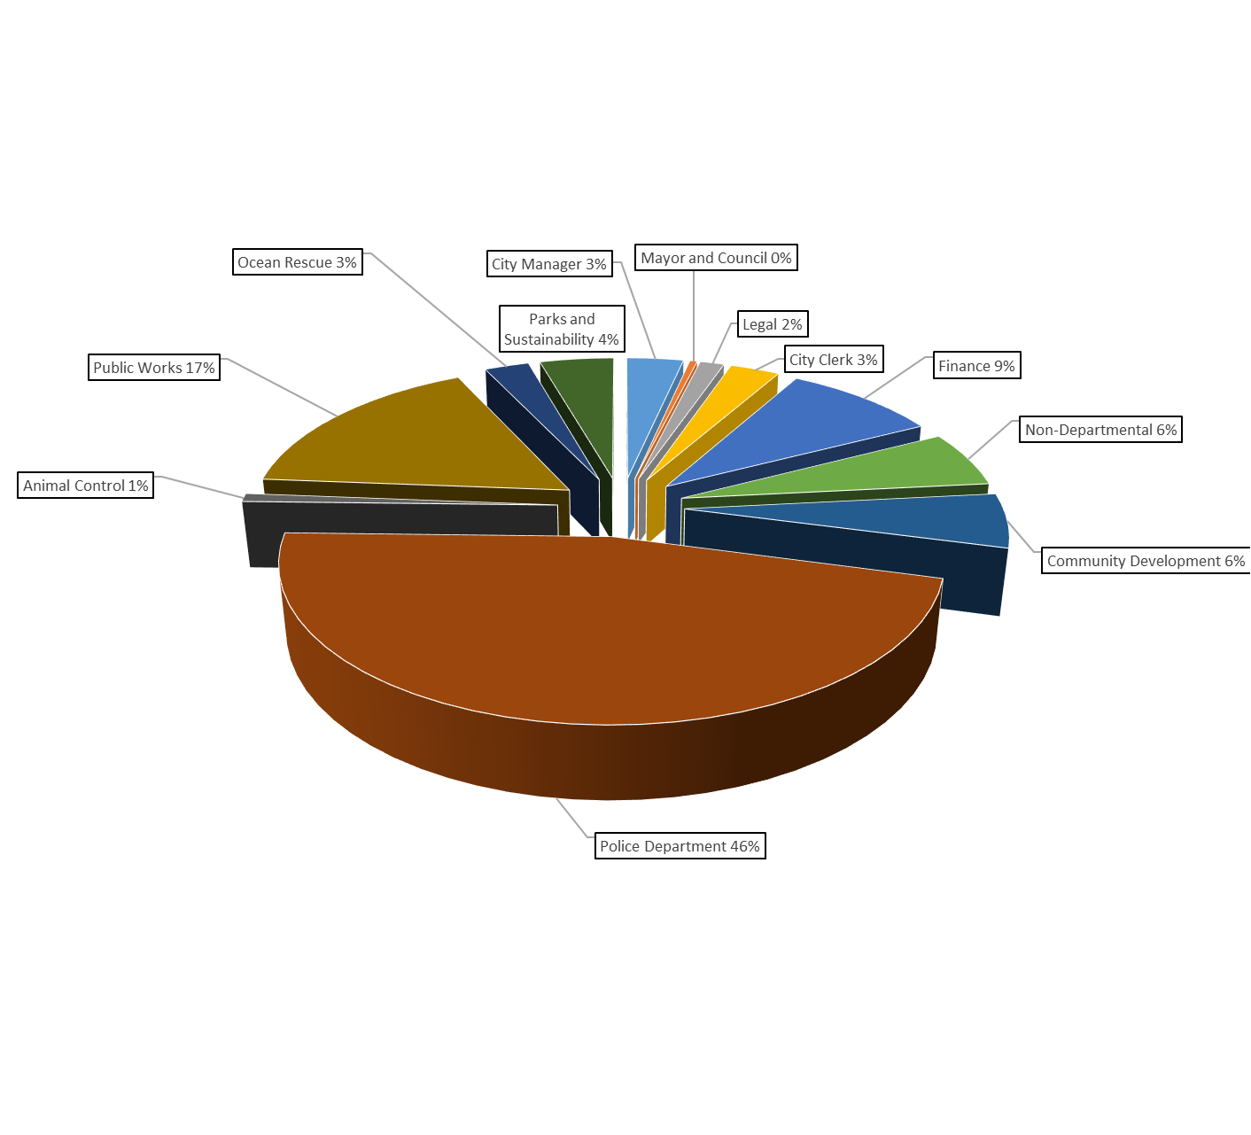
Fiscal Impact – Neptune Beach
Concern:
Where could reductions be made to compensate for +/-
21.8% reduction?
Notes:
- Public Safety to be “held harmless” in legislation

Slide 32
Fiscal Impact – Jacksonville Beach
Concern:
Where could reductions be made to compensate for +/- 20.8% reduction?
Notes:
- Public Safety to be “held harmless” in legislation

Slide 33
The End…for THIS legislative session!
Questions?

Slide 34
Other Legislation Considered
Elimination of Business Tax Receipts (GF Revenue)
Restriction or elimination of Utility Transfers (GF Revenue)
Increasing Sovereign Immunity limits (GF Expenditure/Insurance)
  Currently $200k/individual/event, $300k in aggregate/event
  Senate Bill - $300k/individual/event, $450k in aggregate/event
  House Bill - $500k/individual/event, $1M in aggregate/event

